Slide 1
Project 2: NLP Challenge
G3: Ahmad, Mauricio, Roland, Aleksa

Slide 2
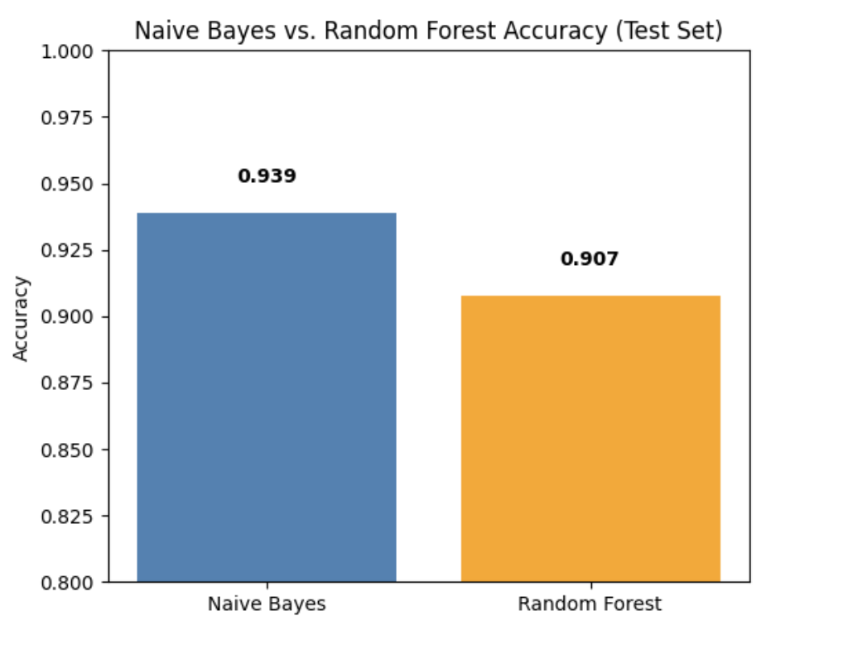
Executive summary
Goal : This project applies Natural Language Processing (NLP) methods to automatically classify news headlines as real or fake.
Using a balanced dataset of nearly 40,000 news articles, a comprehensive pipeline was developed that preprocesses text, extracts features using TF-IDF vectorization, and evaluates multiple classifiers.
Final result Chosen Model achieved 94% accuracy on the test set for classifying news headlines as fake or real.
Model used - Multinomial Naive Bayes with TF-IDF features
Quick recap of alternatives considered - Evaluated Random Forest, XgBoost, Log. Regression and Multinomial Naive Bayes classifiers; compared performance using accuracy, F1-score, and confusion matrix
Other important methodology or considerations:- Used TF-IDF vectorization with n-grams for richer feature representation.

Slide 3
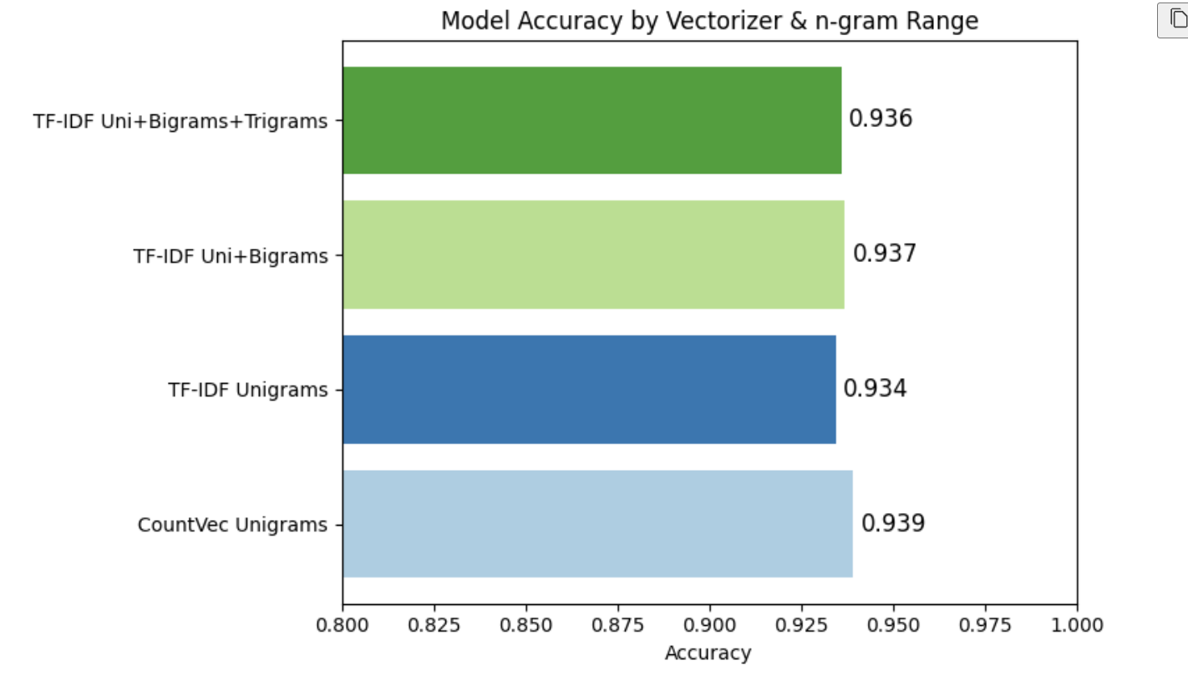
Preprocessing
We experimented with several preprocessing techniques—including removing stop words, lemmatizing words to their root forms, and cleaning out special characters from the text.
Techniques we tried included stemming in the preprocessing pipeline made the features more consistent and contributed to improved classification accuracy.
Switching from CountVectorizer BOW with unigrams to more complex TF-IDF with bigrams and trigrams did not really yield higher accuracy, but in the end I chose TF-IDF because it can potentially capture more nuanced patterns.

Slide 4
Model Config
Naive Bayes (Winner)
We tried Logistic Regression - and changed the parameters - iterations, the solver and the regularization (L1, L2 , elasticnet) but achieved the same performance
We also tried more advanced approaches…

Slide 5
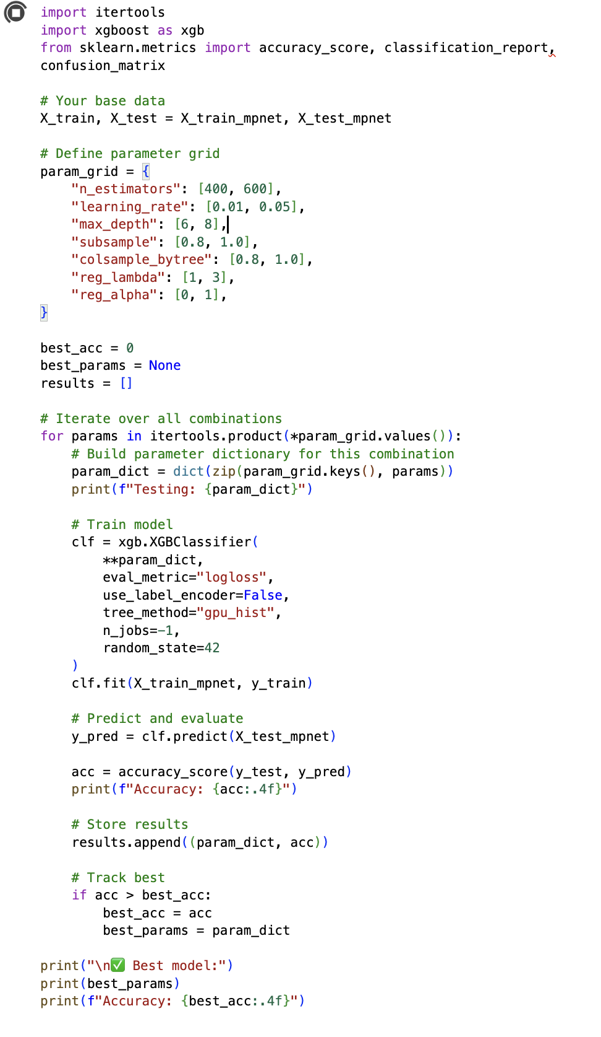
Alternative approaches
We tried using more advanced Models
BoW and TF-IDF create highly dimensional sparse matrices
Random Forest and XgBoost work without embeddings BUT:
training time is long
yields worse performance (no semantic similarity is captured)
Embedding -> all-MiniLM-L6-v2 all‑mpnet‑base‑v2
We tried setting up various parameter combinations
Random Forest ~ 93%
XBoost on Colab with A100 GPU ~ 94%
Testing: {'n_estimators': 800, 'learning_rate': 0.1, 'max_depth': 8, 'subsample': 0.8, 'colsample_bytree': 1.0, 'reg_lambda': 3, 'reg_alpha': 0}

Slide 6
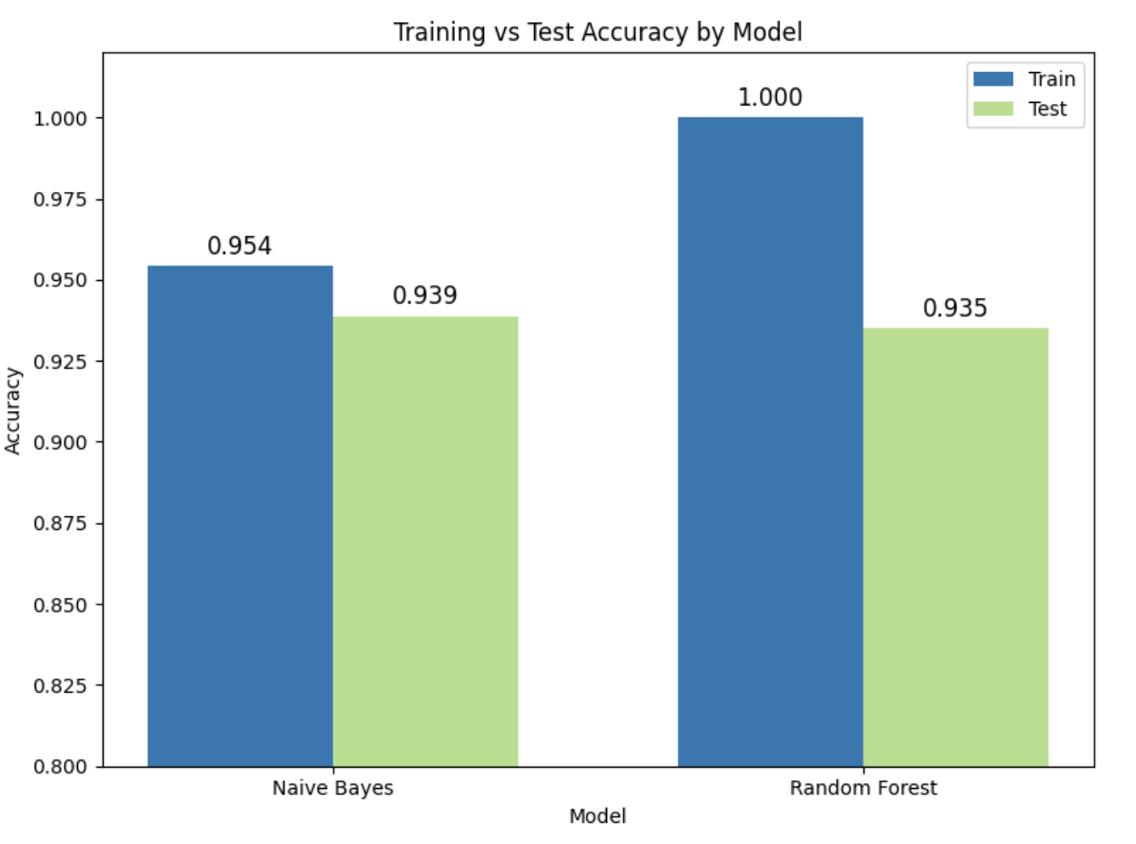
Training vs Validation accuracy
Both NB and RF models score high on test data, but Naive Bayes is more consistent between training and test sets.
Naive Bayes is preferable because it generalizes better—performance on test data closely matches training accuracy, suggesting stronger robustness and less overfitting.
Random Forest, while powerful, may overfit in this scenario due to the nature of the dataset and model complexity, leading to only a small advantage on training data but no real improvement on test data.
Reasons for model choices - Different approaches
Naive Bayes is a classic, proven choice for text and works well TF-IDF feature representations and uses probability.
Random Forest allows your model to learn complicated rules and patterns with decision trees

Slide 7
Takeaways
Recap / conclusions
Adopting TF-IDF vectorization with n-grams allowed the model to weigh terms by relevance and capture meaningful word combinations
Challenges
One of the main challenges was determining which text preprocessing steps and feature extraction techniques would have the biggest impact on accuracy
Key learnings
Simple methods like unigram counts with CountVectorizer BOW can be effective. However, methods like TF-IDF with n-grams offer better flexibility for generalization and are considered best practice for most NLP tasks.
Embeddings together with complex models didn’t yield better results

Slide 8
Instructions
All team members must participate (either split the slides, or discuss the part that you did for each slide)
10 minutes for presentation (HARD limit) + 3 minutes for questions
Tip: Rehearse the presentation at least once
Submit: code + ppt + predictions csv on a github repo
Deadline: Friday 16:30pm. Presentations will start around that time so we have a 30-min buffer to account for technical issues
Each student must submit their own answer to the Ironhack portal
Group members may submit the same repo

